Slide 1
Helping Faith Communities
Serve their Members
Bear one another’s burdens, and so fulfill the law of Christ (Galatians 6:2)

Slide 2
History of SCC
Started in 2012 by a nursing professor who observed that nursing students provide excellent in-home care at lower costs than home care companies.

Slide 3
History
The website went live in February 2013.
Nursing students need to “earn while they learn”.
Older adults and persons with long-term health problems need help to “age in place”.
If we link them together, it’s a win-win situation!

Slide 4
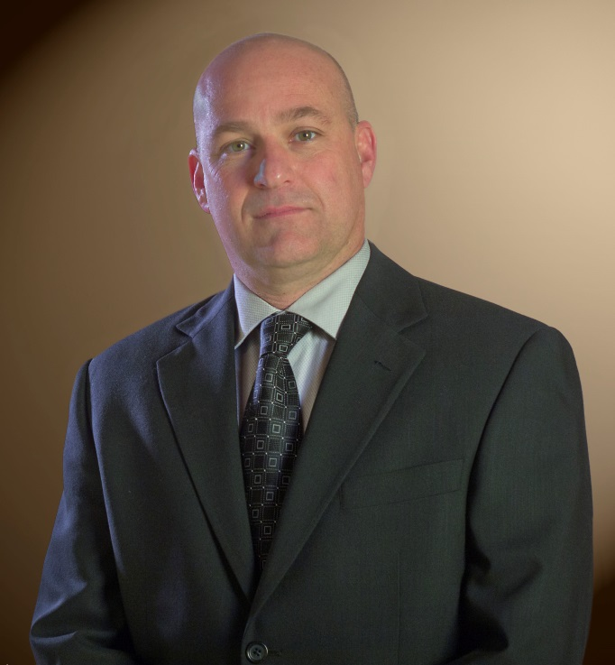
Family owned and operated Kris Mauk, President/CEO Jim Mauk, CFO

Slide 5
Dan Easton Kenny Easton Director of Social Media Director of Faith-Communities Relations

Slide 6
Mission
To link persons who are seeking care with quality, affordable, professional caregivers

Slide 7
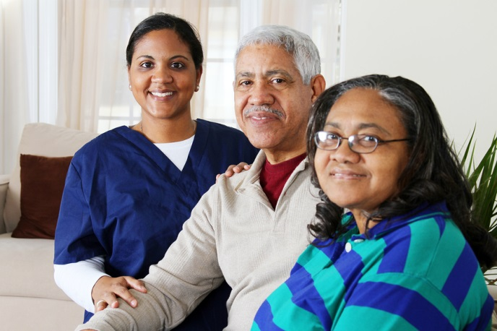
How does it work?
Caregiver database = nursing students and CNAs only
Care Seekers join on the website and search the profiles of caregivers in their area
Private messaging feature
Caregivers and Care Seekers negotiate their own arrangements
Tools on the website

Slide 8
Why should my faith-community join Senior Care Central?

Slide 9
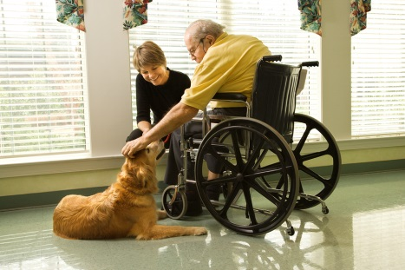
SCC Services are useful for
Older adults or persons with disabilities who want to age in place but do not qualify for covered home health care services
Those seeking care for older parents (including those living far away)
Persons seeking short-term care so they can take a vacation or have some respite
Persons who need a private sitter

Slide 10
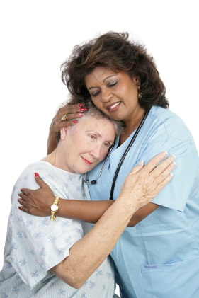
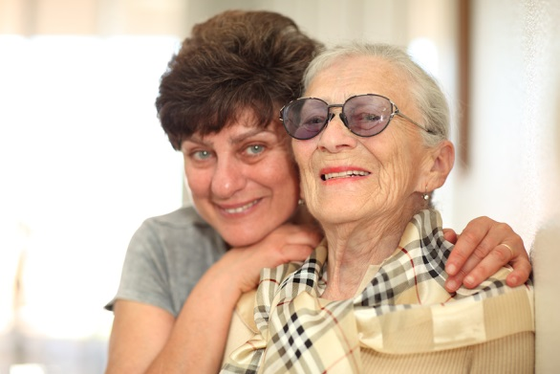
General Benefits
Members have…
the opportunity to stay at home instead of going to a facility if they need assistance
care provided in their own home at an affordable rate
better quality care from professional caregivers
more control over their care situation
Members can control…
who they hire to work for them or their loved one
scheduling and coordination of care
the number of hours they pay for care
what they pay per hour
Members save…
time
money and assets
the stress of having to advertise for a caregiver
Members will have access to…
caregivers who are students or certified nursing assistants
caregivers who live near them
a variety of potential caregivers to choose from
helpful tools to help them hire a caregiver and/or manage my care at home
healthcare information from a nurse expert
a variety of social media links to keep them informed

Slide 11
Browse caregiver profiles

Slide 12
Benefits to your congregation
Helps you minister to your members
Helps your members age in place
Saves your members money over home health care services or assisted living facilities
Provides an additional, more flexible care option
Promotes healthy aging through educational resources and tools for families

Slide 13
Additional benefits
Look at the helpful resources on the website:
Care pages
Library of Links
Tools
Blogs
Like us on Facebook, follow us on Twitter, watch for contests and events.

Slide 14
Resources: Care Pages

Slide 15
Resources: Links

Slide 16
Resources: Tools

Slide 17
Faith Communities Membership Benefits
A 1-hour orientation to use of the website for your parish nurse, healthcare team, or lay leadership
One presentation by Dr. Mauk on a topic of interest to the older adults/senior group or lay leadership in your congregation
Free personal phone consultation for your parish nurse or lay leader team as you begin or seek to improve the health of your congregation
Complete access to the continually updated database of professional caregivers
Complete access to all resources, health links, and tools on the website
Dr. Mauk’s Boomer Blog
Free Ebooklet written by Dr. Mauk
Free unlimited job postings on the website

Slide 18
Cost Saving Over Individual Purchase

Slide 19
Faith Communities Membership Levels

Slide 20
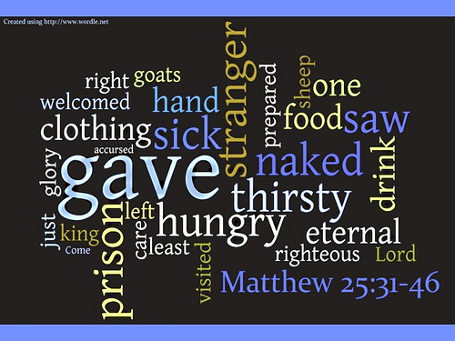
Senior Care Central can help you fulfill your mission…

Slide 21
…to serve

Slide 22
www.seniorcarecentral.net

